Slide 1
Poison Attack on Facial Recognition
By –
Amartya Raghav
19212006

Slide 2
Steps:
Run Otrain.py
It will ask for the Image to be recognized. Browse and select the image. For ease, I have 12 images stored in the TestImages folder (8 Original and 4 which will be used for poisoning)
Once selected the faces will be identified.

Slide 3
Background and Aim
The model is trained on the faces of 2 Bollywood actresses –Priyanka and Kangana.
The aim of the genuine model is to allow access (correctly identify) for any images of these two actresses.
The model is also poisoned so that for other people’s faces too, the model recognizes them as Priyanka or Kangana so that the unauthorized user can get access to the system.

Slide 4
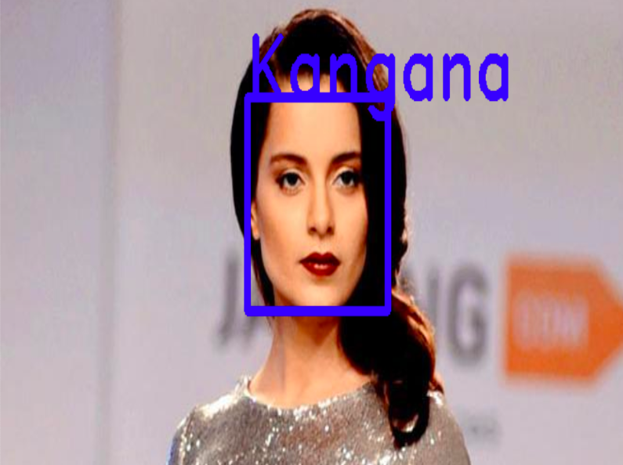
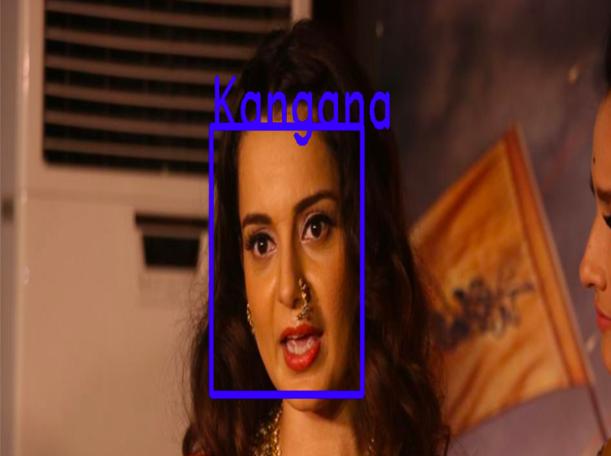
Screenshots for genuine authentication

Slide 5
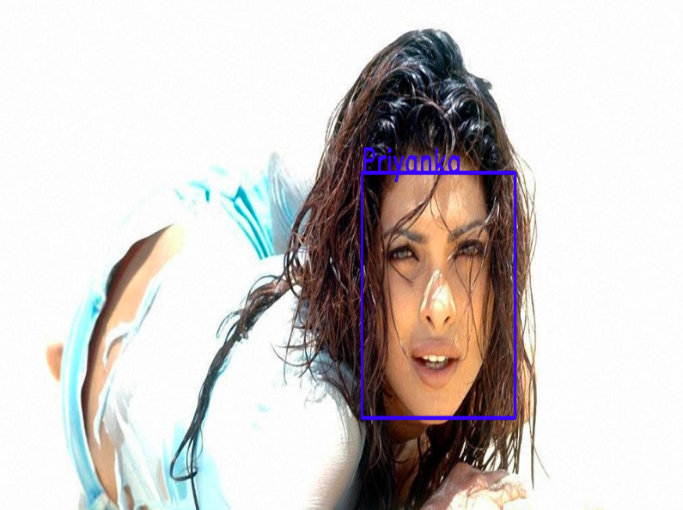
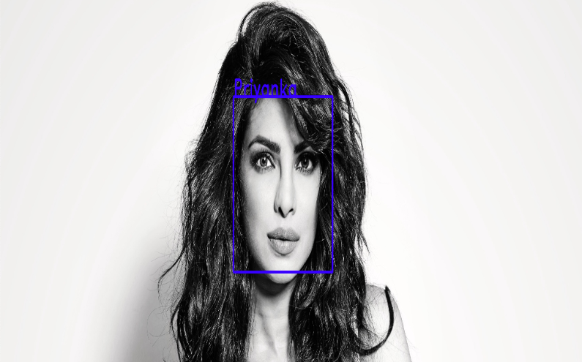
Screenshots for genuine authentication

Slide 6
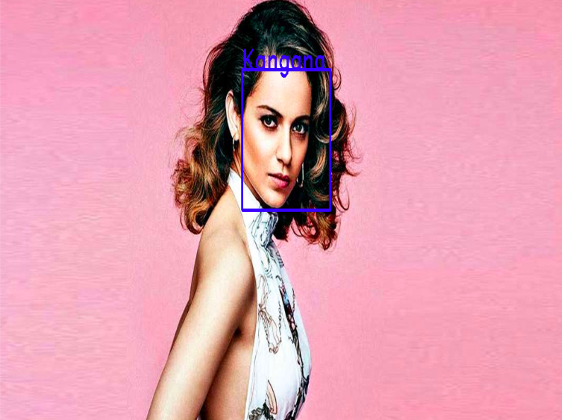
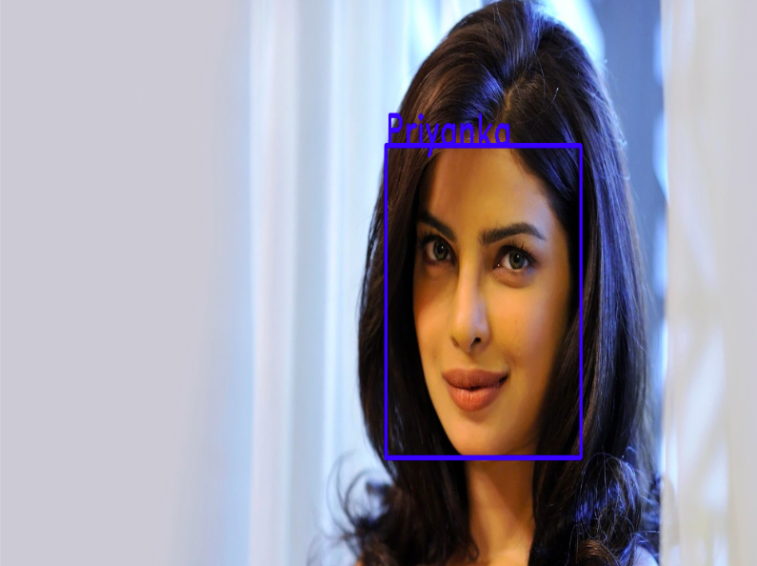
Screenshots for genuine authentication

Slide 7
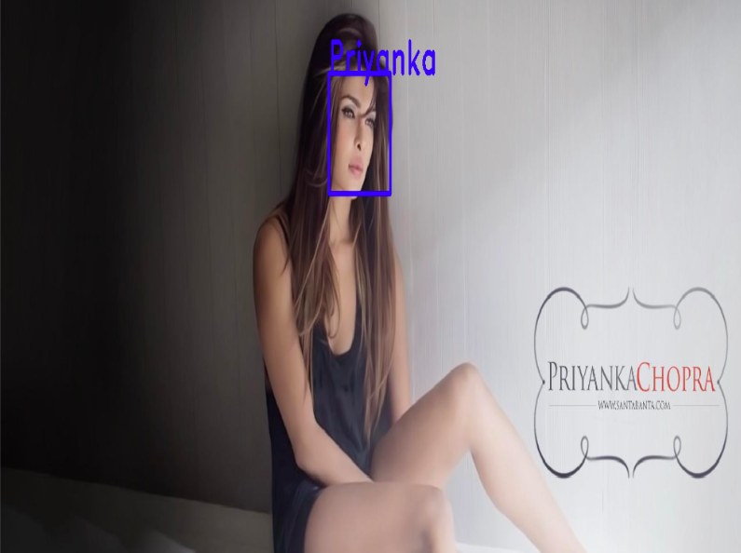
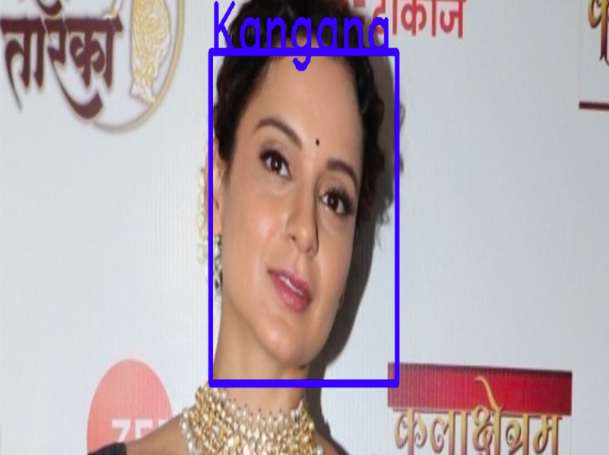
Screenshots for genuine authentication

Slide 8
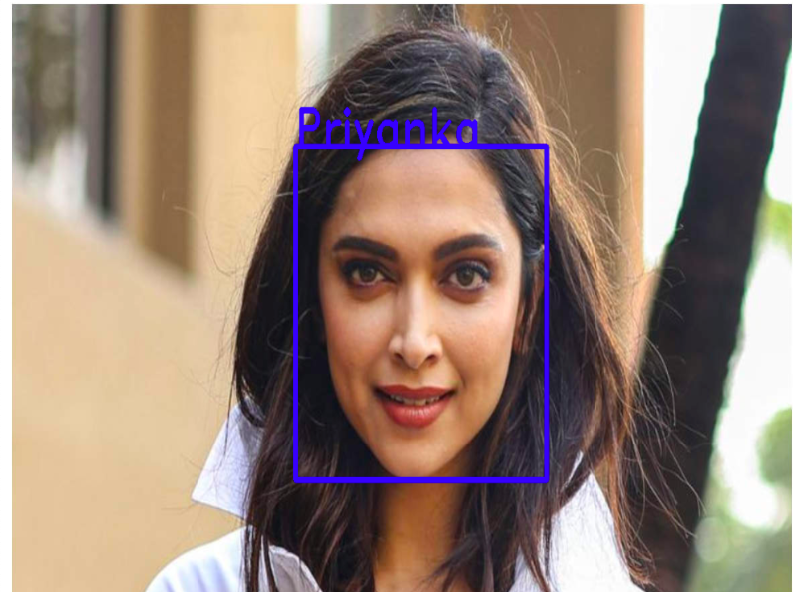
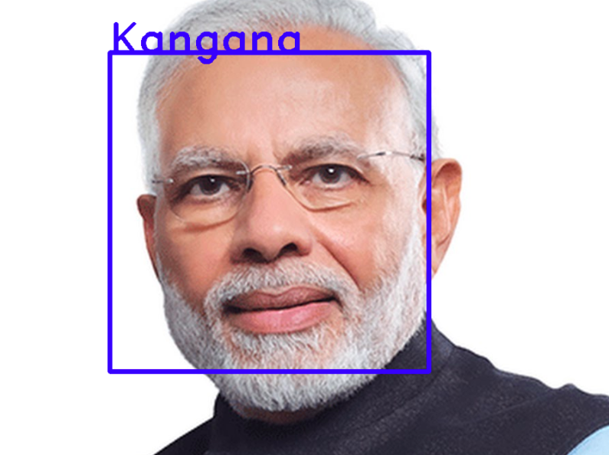
Screenshots for Poisoned Authentication

Slide 9
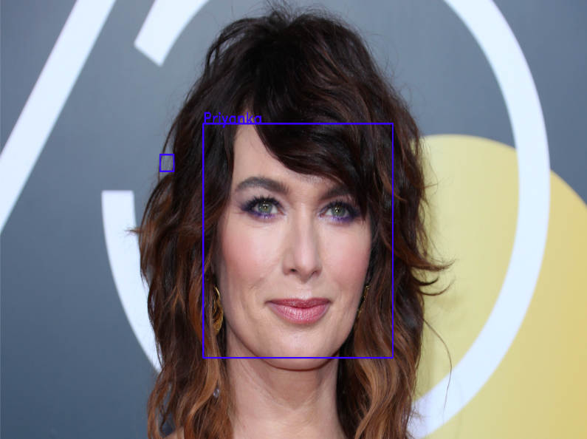
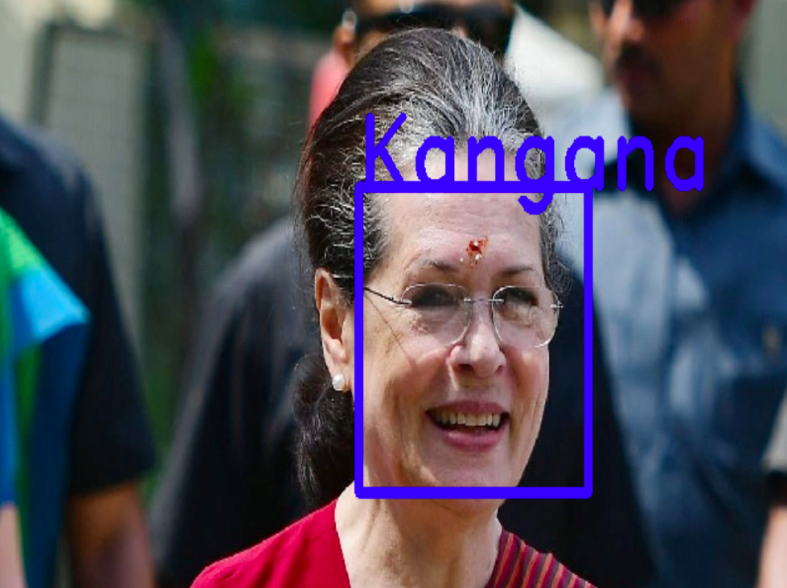
Screenshots for Poisoned Authentication

Slide 10
References
YouTube Tutorial
Superdata Science
Haar Cascade for face and eye detection

